Slide 1

BELL RINGER
Bases produce what kind of ions?
What is neutralization?
`EOC QUESTION:
  Which statement is true of an aqueous solution of KOH?
  A) It has a very low pH.
  B) It will dissolve many metals.
  C) It will react with HCl to produce water.
  D) It will produce hydronium ions in water.
Be prepared for a SEATING CHART ☺

Slide 2

HEAT
ENERGY
and

Slide 3
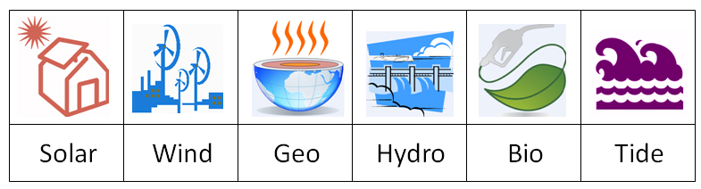

What is ENERGY ?
the “stuff” that makes “stuff do stuff”
OR
the ability to do work. (W=F x D)

Slide 4

Law of Conservation of ENERGY
Energy can not be created or destroyed but is transformed from one form to another.

Slide 5
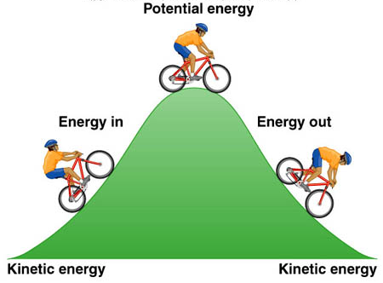
Types of ENERGY
Potential Energy
Kinetic Energy
Energy due to height of an object.
Stored energy
Examples
Books on a desk
At the top of a mountain
At the top of a slide
Water at the top of the falls
Energy from motion. The faster an object is, the higher the kinetic energy.
Examples
Books falling
Skiing down a mountain
Sliding down a slide
Water going over the falls

Slide 6
FORMS OF ENERGY
Mechanical
Heat or
Thermal
Chemical
Electrical
Electromagnetic
Nuclear

Slide 7
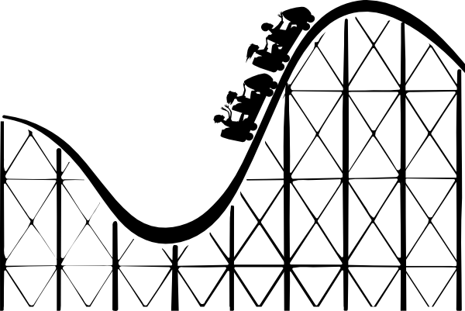
Mechanical Energy
Energy of motion or position
Not 100% efficient much lost to heat
Sound, wind, waterfall, compressed spring, moving machine parts

Slide 8

Heat / Thermal Energy
The internal motion of an objects atoms and molecules.
Measured by temperature.
The faster particles move, the more thermal energy they have.
Fire

Slide 9
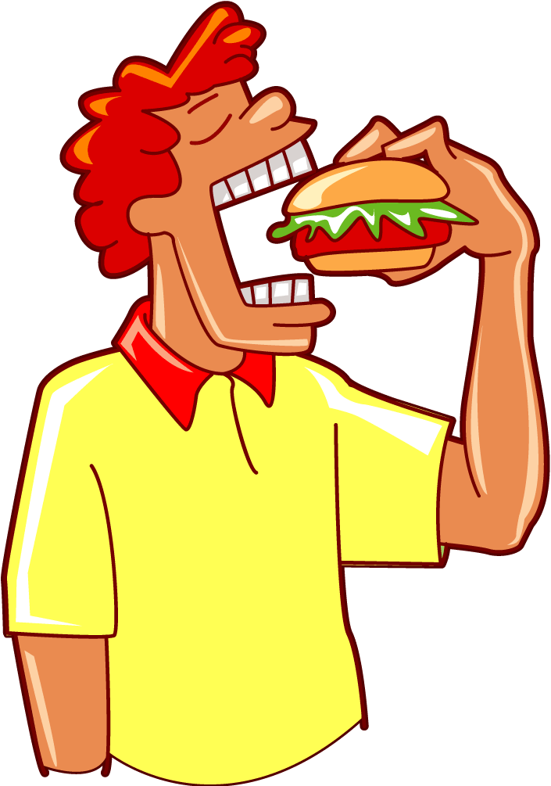
Chemical Energy
Energy stored by chemical bonds in an object.
When bonds are broken, energy is released.
gasoline, food, coal, wood

Slide 10

Electrical Energy
Moving electrical charges.
Electricity from batteries, power lines, lightning

Slide 11
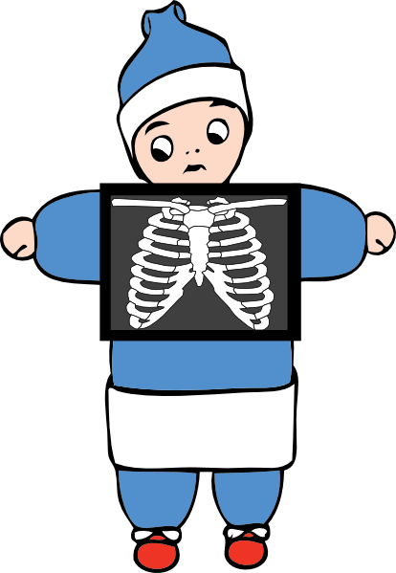
Electromagnetic (Radiant) Energy
Energy that travels in waves; have electrical and magnetic properties
Light, Magnetism, X-Rays, Radio waves, microwaves, ultraviolent and infrared radiation

Slide 12

Nuclear Energy
Energy stored in center (nucleus) of an atom
Most powerful
Potential Energy only
Fission (breaking apart), Fusion (forming), Sun

Slide 13
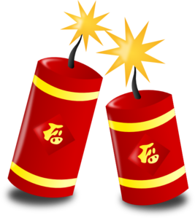
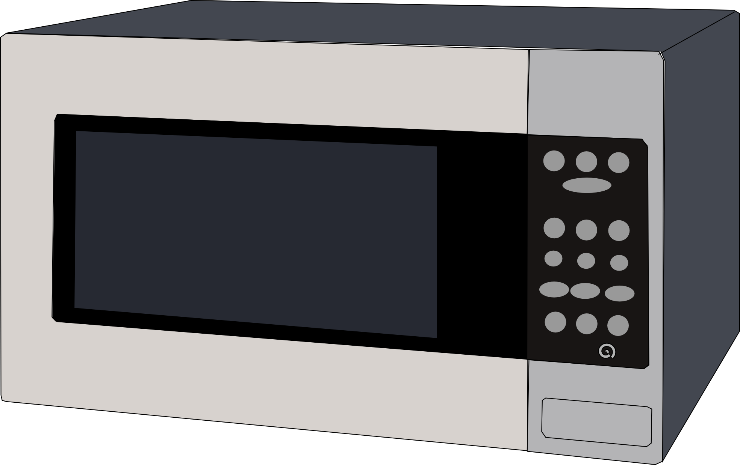
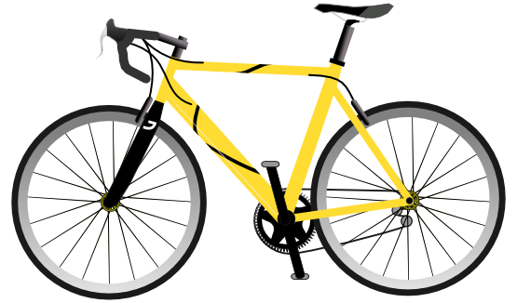

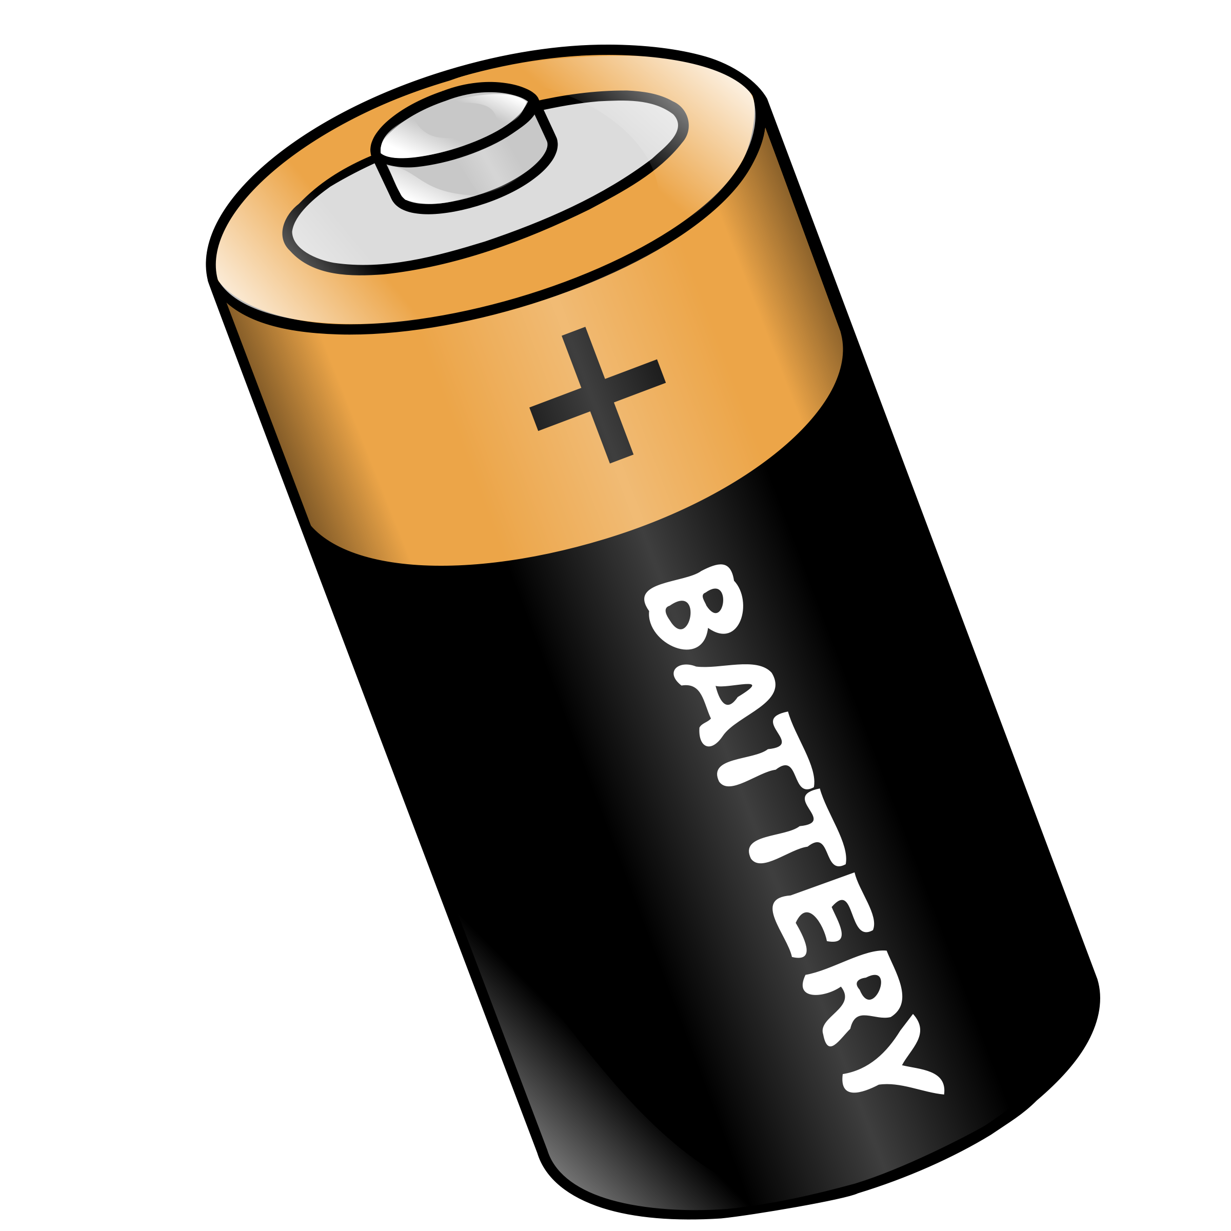
Try the Following

Slide 14
Try the Following
Windmill – Mechanical (wind) → Mechanical (turning blades)
Flashlight – Chemical & Electric (batteries) → Radiant (light) & Thermal (heat)
Microwave – Electric (outlet) → Radiant (light), Mechanical (Sound) & Thermal (heat)
Firecracker – Chemical → Thermal (heat), Radiant (light), Mechanical (sound)
Bicycle – Chemical (cells in body) → Mechanical (legs peddling) & Mechanical (bicycle)
Battery – Chemical & Electrical → nothing until it is used

Slide 15
Try the Following
Electrical to Thermal –
Chemical to Thermal –
Electrical to Mechanical –

Slide 16
Try the Following
Electrical to Thermal
electric blanket, hair dryer, electric heater, electric stove top,
toaster
Chemical to Thermal
chemical digestion, burning fossil fuels, a lighter
Electrical to Mechanical
blender, mixer, baby swing, ceiling fan

Slide 17
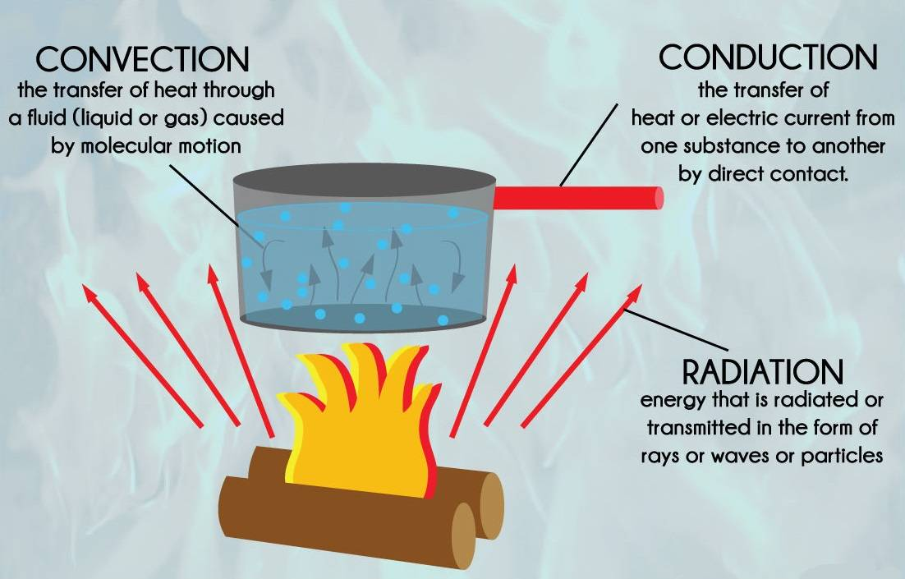
What is HEAT TRANSFER?
The exchange of thermal energy between physical systems.
Thermal energy is the energy that comes from heat.
This heat is generated by the movement of tiny particles within an object.
The faster these particles move, the more heat is generated.

Slide 18
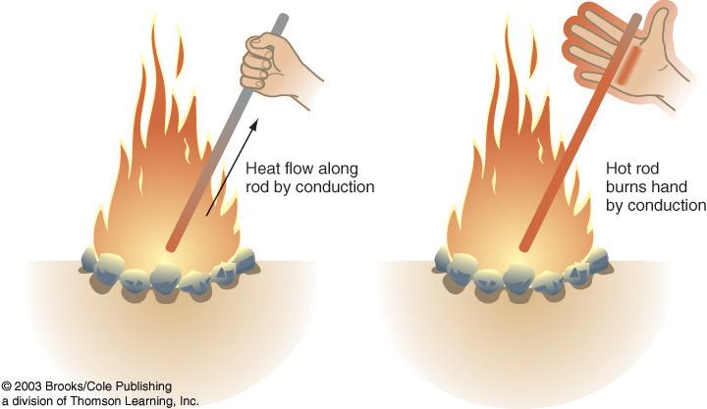
CONDUCTION
Transfer of heat by direct contact.
Heated atoms and molecules collide with cooler molecules and transfer their kinetic energy.
Touching a hot stove
A metal spoon getting hot when placed in boiling water

Slide 19
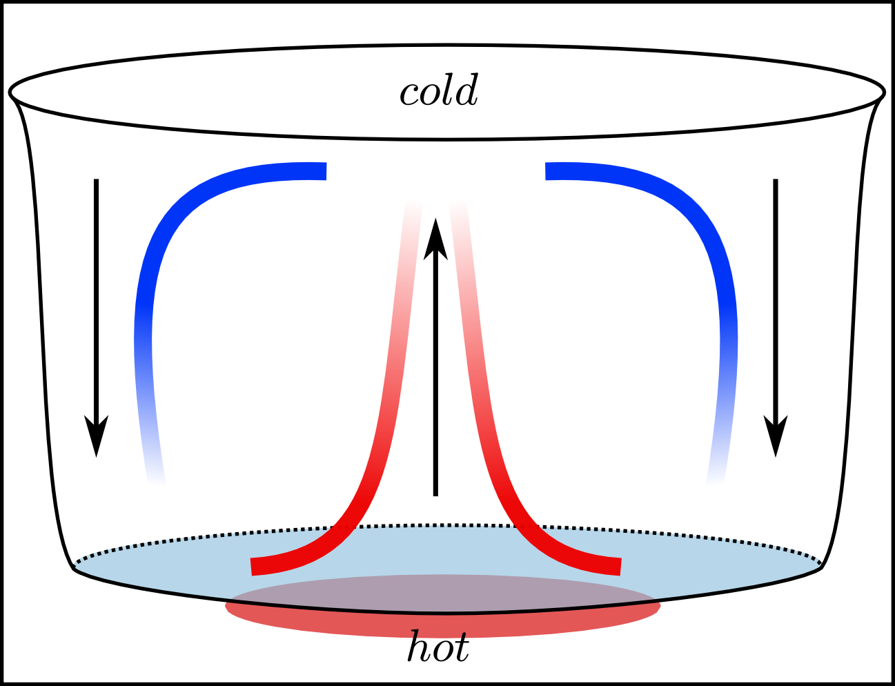
CONVECTION
Transferring heat in liquids and gases by the mass movement of molecules.
Hot rises and cold sinks forming convection currents.
A pot of water on a stove. Water is heated in the bottom and rises while cool water sinks to the bottom.

Slide 20
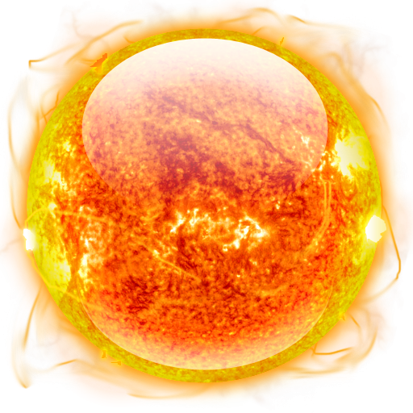
RADIATION
Transfer of heat by electromagnetic waves.
Does not require matter to be transferred
Face warming in the sun.
Heat from a fire.

Slide 21
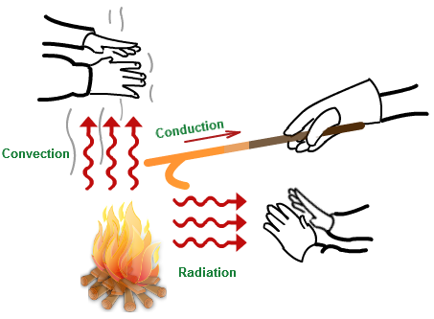

Slide 22
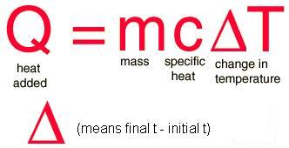
SPECIFIC HEAT
The specific heat is the amount of heat per unit mass required to raise the temperature by one degree Celsius.
Q = measured in Joules (j)
M = measured in grams (g)
C = measured in J/g°C

Slide 23
SPECIFIC HEAT
How much heat is needed to raise the temperature of 100.0 g of water by 85°C if the specific heat of water is 4.186 J/g°C?
How much heat is absorbed by a 750-g iron skillet when its temperature is raised from 25°C to 125°C? The specific heat of iron is 0.449 J/g°C.

